Slide 1


Hope to Skills
Lecture# 14
Irfan Malik, Dr. Sheraz Naseer

Slide 2
Agenda
Recap
Five number summary
Correlation
Data Visualization
Sea Born
Colab notebook
Quiz

Slide 3
Data Visualization
Data visualization is the graphical representation of data and information. It involves creating visual elements such as charts, graphs, and maps to help people understand complex data patterns.

Slide 4
Importance of data Visualization
Enhances Data Understanding
Identification of Patterns and Trends
Quick Problem Identification
Narrative Building

Slide 5
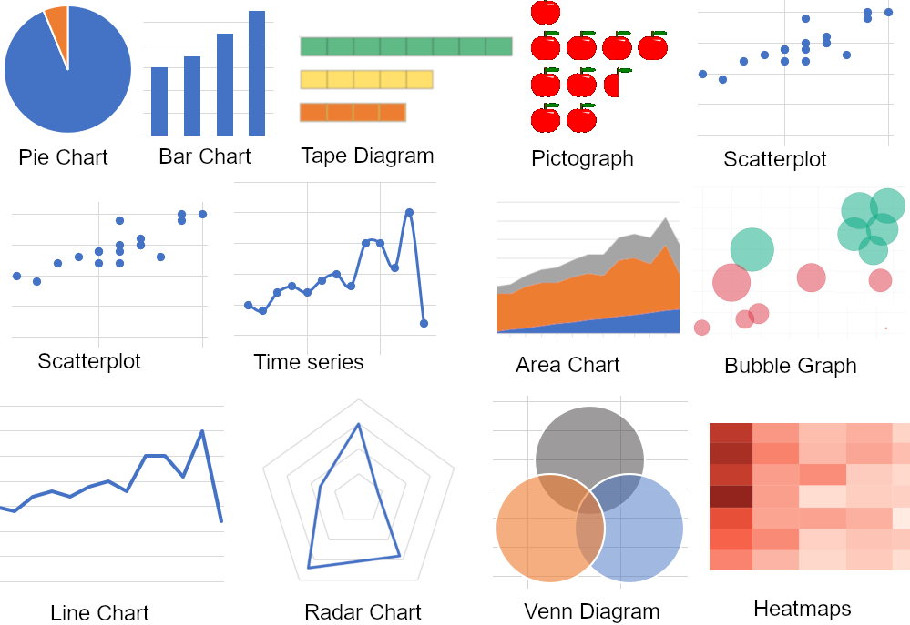
Types of Data and Visualization
Different data types require different visualization techniques to convey insights accurately.

Slide 6
Categorical Data
Categorical data consists of distinct categories or labels.
Examples: Gender, color, product type.
Common visualization techniques: Bar charts, pie charts, stacked bar charts.

Slide 7
Categorical Data
Nominal Data: represents categories without any inherent order or hierarchy.
Examples:
Colors (Red, Blue, Green)
Ordinal Data: Ordinal data represents categories with a natural order or hierarchy.
Examples:
Educational Level (High School, Bachelor's, Master's, PhD)
Rating (Poor, Fair, Good, Excellent)

Slide 8
Numerical Data
Numerical data consists of numerical values that can be measured or counted.
Examples: Age, temperature, sales revenue.
Common visualization techniques: Histograms, line charts, scatter plots.

Slide 9
Seaborn

Slide 10
Introduction to Seaborn
Seaborn is a popular Python data visualization library built on top of Matplotlib and pandas.
It provides a high-level interface for creating informative and visually appealing statistical graphics.
Seaborn simplifies the process of generating complex visualizations and supports a wide range of plot types.

Slide 11
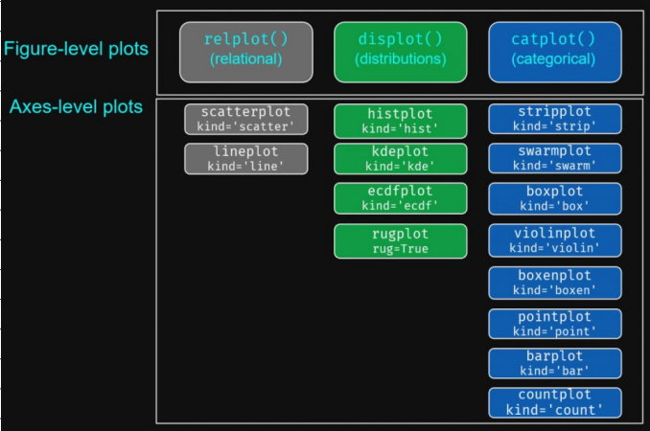
Types of plots in SeaBorn

Slide 12
Lets move to Google collab

